Slide 1




TECHNICAL PRESENTATION · CO1 ASSESSMENT TOOL 3
Computer Vision Applications in Agriculture
Presented by:
B. Charan Kumar Reddy
192472195
Course: ITA0512 — Computer Vision

Slide 2



INTRODUCTION
Why Agriculture Needs Computer Vision
Manual field scouting — Human inspection of crops, pests, and soil is slow, inconsistent, and cannot scale to large farms.
Growing food demand — Global food production must rise sharply in coming decades, while arable land and farm labor are shrinking.
~70%
40%
more food output needed
by 2050 (FAO estimate)
of global crop yield lost
to pests & disease yearly
Delayed decisions cost yield — Disease, weeds, or water stress are often noticed only after visible damage — losses are already locked in.
Data-rich, low-cost sensing — Drones, phone cameras, and satellites now make continuous visual data cheap to capture across a farm.
24/7
cm-level
continuous visual monitoring
via cameras & drones
precision achievable with
drone/satellite imaging
ITA0512 · Computer Vision | CO1 Assessment Tool 3
2

Slide 3

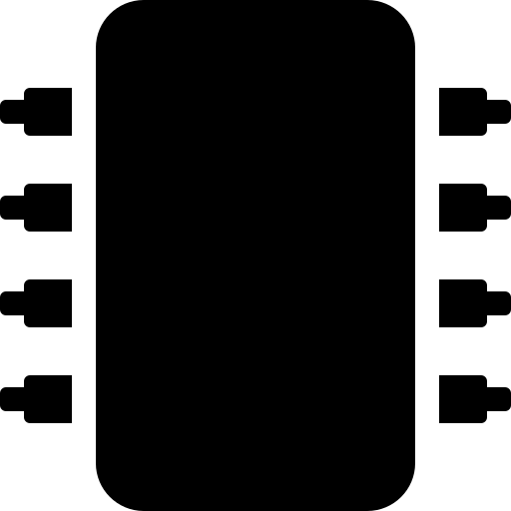


APPLICATION 01
Crop Disease & Pest Detection
The Problem Farmers spot leaf spots, blight, or pest damage only after infection has spread, since manual scouting covers a tiny fraction of large fields each day.
Structured Detection Pipeline
→
→
→
Image
Capture
Pre-
processing
CNN
Classification
Diagnosis
& Alert
The Solution
Capture leaf images via smartphone or UAV camera in the field
Train a CNN (e.g., ResNet/MobileNet via transfer learning) on labelled disease datasets such as PlantVillage
Classify the leaf image and localize the affected region with Grad-CAM visual heatmaps
Push an instant alert with a treatment recommendation to the farmer's app
Structured Tools & Tech Stack
TensorFlow / Keras · CNN transfer learning (ResNet50, MobileNetV2)
PlantVillage & field-collected labelled leaf datasets
OpenCV for image pre-processing & augmentation
Mobile app (Android/iOS) for farmer-facing alerts
ITA0512 · Computer Vision | CO1 Assessment Tool 3
3

Slide 4

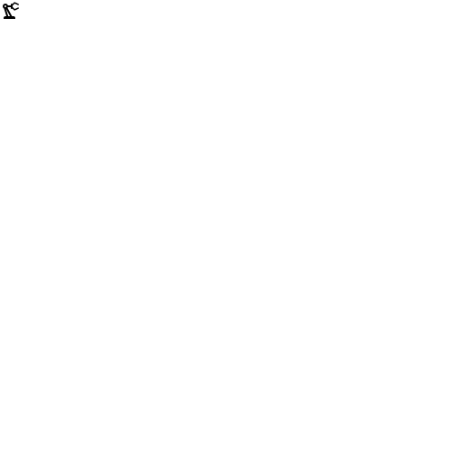
APPLICATION 02
Weed Detection & Precision Spraying
The Problem: Blanket herbicide spraying treats entire fields uniformly — wasting chemicals, raising cost, and harming soil health, since weeds are scattered unevenly among crop rows.
TRADITIONAL METHOD
COMPUTER-VISION SOLUTION
Herbicide sprayed uniformly over full field
High chemical cost & runoff pollution
No distinction between crop and weed
Weeding labor is slow and manual
Real-time object detection (YOLOv8) on a camera-equipped sprayer boom classifies crop vs. weed per frame
Detected weed coordinates trigger targeted nozzle actuation within milliseconds
Herbicide use cut drastically — sprayed only where weeds exist
Runs on an embedded GPU (e.g., NVIDIA Jetson) mounted on tractor or drone
ITA0512 · Computer Vision | CO1 Assessment Tool 3
4

Slide 5

APPLICATION 03
Fruit Classification & Robotic Harvest
The Problem Manual yield estimates are rough guesses, and hand-harvesting is labour-intensive with a narrow ripeness window — delays mean fruit is picked too early or spoils on the vine.
Detection-to-Harvest Workflow
Orchard imaging RGB + depth camera scans rows via drone or ground robot
Detect & count Mask R-CNN segments each fruit; tallies yield per tree
The Solution
Detect & count fruit per tree using instance segmentation (Mask R-CNN / YOLO-seg)
Estimate ripeness from colour, size, and texture cues to forecast the harvest window
Guide a robotic arm with stereo-depth cameras to pick only ripe fruit precisely
Ripeness scoring Colour/size analysis predicts optimal picking date
Robotic picking Robotic arm plans grasp and harvests selectively
ITA0512 · Computer Vision | CO1 Assessment Tool 3
5

Slide 6

APPLICATION 04
Soil & Crop Health Monitoring via Remote Sensing
The Problem Water stress, nutrient deficiency, or soil degradation spread across large fields unnoticed until visible wilting appears — by then, yield loss is already underway.
Structured Tools & Technology Stack
Sensing Hardware RGB, multispectral & depth cameras · UAV drones · satellite feeds
Vision Models CNNs (ResNet/MobileNet), YOLOv8 detection, Mask R-CNN segmentation
The Solution
Drones/satellites capture multispectral imagery across the field on a set schedule
Compute vegetation indices (e.g., NDVI) pixel-by-pixel to flag stressed zones
Overlay results on a GIS map to trigger targeted irrigation or fertilizer response
Frameworks TensorFlow, PyTorch, OpenCV, Roboflow for dataset & pipeline ops
Analytics & Ops GIS/NDVI mapping, cloud dashboards, robotic actuation & mobile alerts
Simplified NDVI Health Map
Low vegetation health (stressed)
High vegetation health (thriving)
ITA0512 · Computer Vision | CO1 Assessment Tool 3
6

Slide 7
Thank You
Questions & Discussion Welcome
Computer Vision in Agriculture | ITA0512 | CO1 Assessment Tool 3

Slide 8
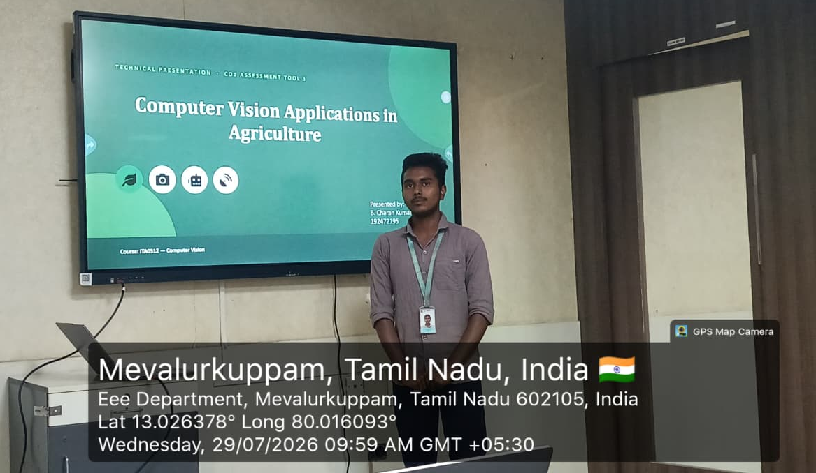
Geotag Photo:

